Slide 1
Big Mountain Resort Analysis
Kylene Hill

Slide 2
The problem -
Big Mountain Resort does not currently have a pricing strategy that is based off of the value of the resort, which is an accumulation of the value of it’s features.
“
At what ticket price, or range of prices, can Big Mountain Resort support that reflects not only the value of the resort as it compares to other resorts in its market share, while also mitigating the recent operating expenses of $1.5M?
”

Slide 3
Recommendations and Key Findings
Upon analysis of how Big Mountain Resort compares to other resorts in the US, we have found that BMR holds some of the top-valued features at it’s resort already. However, using a data driven approach for pricing strategy, Big Mountain Resort is in a position to leverage the best features to increase the ticket price leading to increased profit margins with two initial steps:
Add a run and ski lift, increasing the vertical drop by 150 ft, and increase ticket price by $1.99
Eliminate the least used run

Slide 4
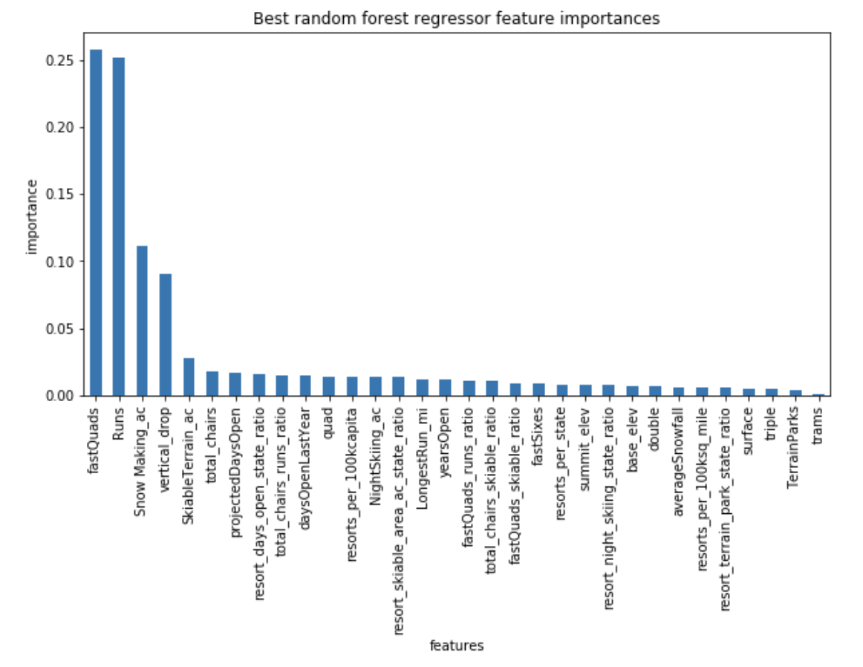
We found that of all the features, only a few were strongly correlated to ticket price:
4 Seater Lifts
Runs
Snow Making (acres)
Vertical Drop
Note BMR is among the leading resorts for all of these except for Vertical Drop; BMR’s Vertical Drop is high but there are still many resorts with a greater drops.

Slide 5
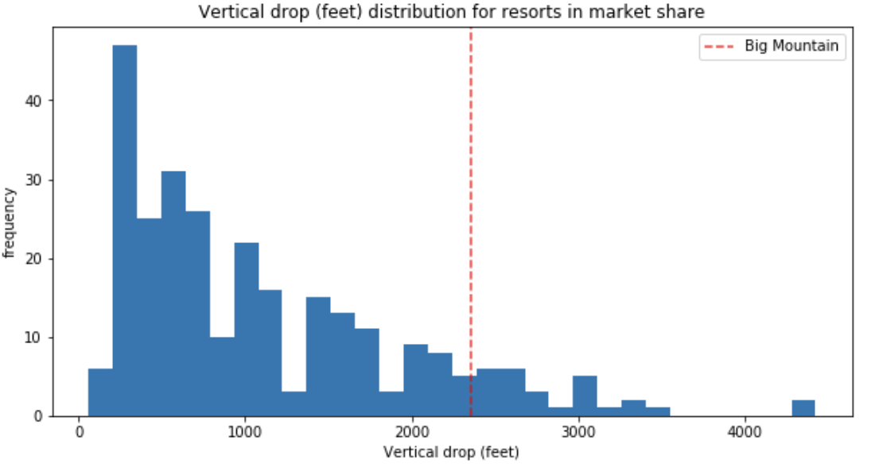
Vertical Drop for Big Mountain and other resorts

Slide 6
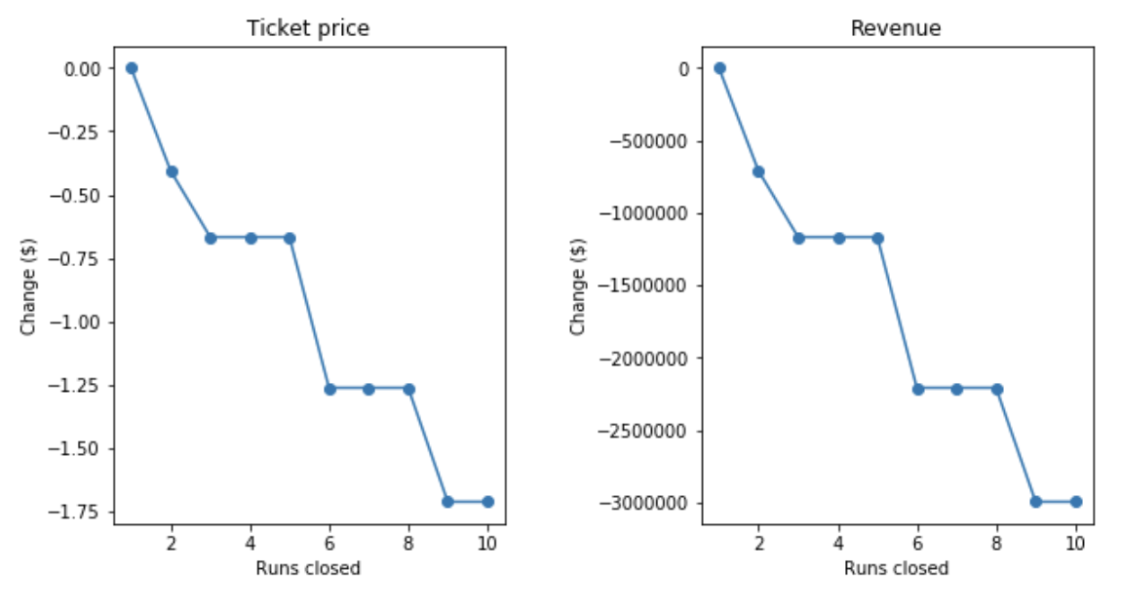
We also saw the impact on revenue as the number of runs could be shut down.

Slide 7
Conclusion
The new ski lift and increased vertical drop, in combination with an increased ticket price would bring in an additional $3M+ in ticket revenue. As well, reducing the least used run would reduce operating costs by a given amount which would further increase profit margins for Big Mountain Resort.
Depending on what BMR’s finances look like with overall operating expenses, low hanging fruit would be to increase ticket price slightly and eliminate the least used run. From there, investments can be made to increase the drop and increase ticket price to bring in more revenue for Big Mountain Resort.

